Slide 1
Inventory Costing Methods
Inventory is accounted for at cost.
  Cost includes all expenditures necessary to acquire goods and place them in a condition ready for sale.
  Unit costs are applied to quantities to compute the total cost of the inventory and the cost of goods sold using the following costing methods:
    Specific identification
    First-in, first-out (FIFO)
    Last-in, first-out (LIFO)
    Average-cost

Slide 2
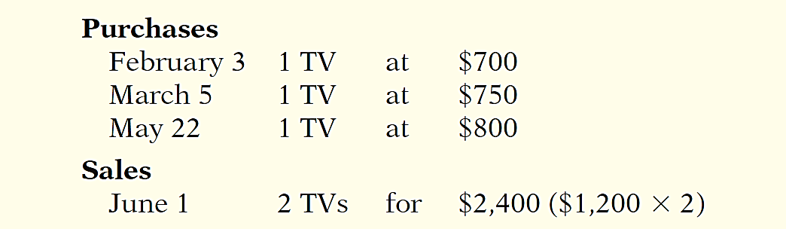
Inventory Costing
Illustration:
Crivitz TV Company purchases three identical 50-inch TVs on different dates at costs of $700, $750, and $800. During the year Crivitz sold two sets at $1,200 each. These facts are summarized below.

Slide 3
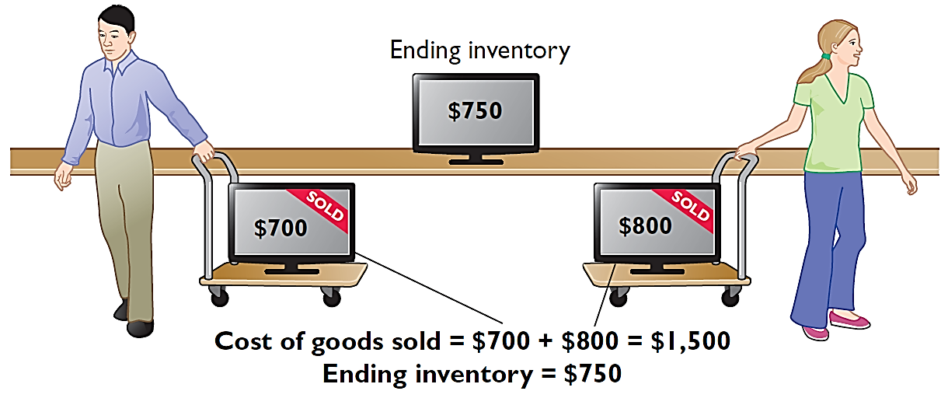
Specific Identification
If Crivitz sold the TVs it purchased on February 3 and May 22, then its cost of goods sold is $1,500 ($700 + $800), and its ending inventory is $750.

Slide 4
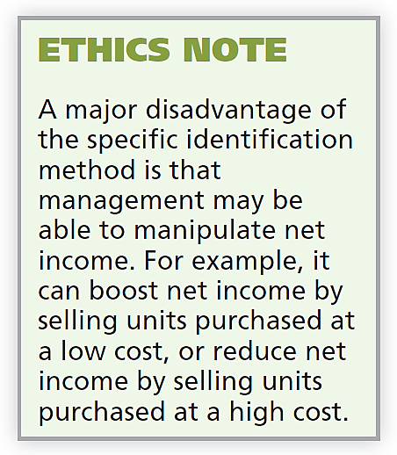
Specific Identification
Actual physical flow costing method in which items still in inventory are specifically costed to arrive at the total cost of the ending inventory.
  Practice is relatively rare.
  Most companies make assumptions (cost flow assumptions) about which units were sold.

Slide 5
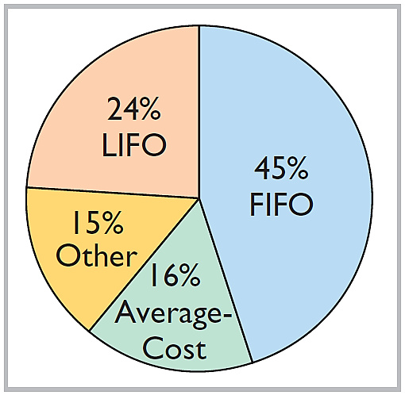
Cost Flow Assumptions
Cost flow assumptions DO NOT need to be consistent with the physical movement of the goods
Use of cost flow methods in 500 large U.S. companies

Slide 6
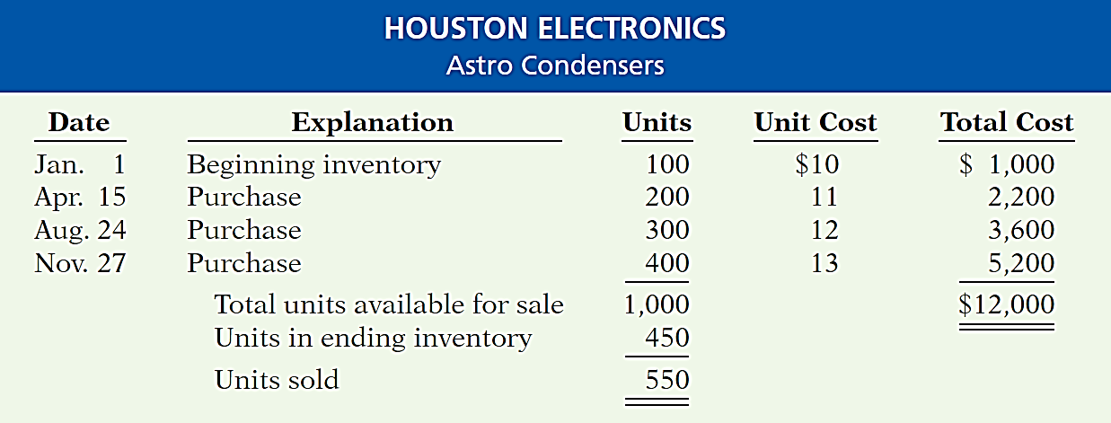
Cost Flow Assumptions
Rising prices!!!
Illustration (assuming a periodic inventory system):
Cost of 550 units = COGS
(Beginning Inventory + Purchases) - Ending Inventory = COGS
  COGS depends on the ending inventory AND the value of the ending inventory will depend on the cost of flow method used

Slide 7
Cost Flow Assumptions
FIRST-IN, FIRST-OUT (FIFO)
  Costs of the earliest goods purchased are the first to be recognized in determining cost of goods sold.
  Often parallels actual physical flow of merchandise.
  Companies determine the cost of the ending inventory by taking the unit cost of the most recent purchase and working backward until all units of inventory have been costed.

Slide 8
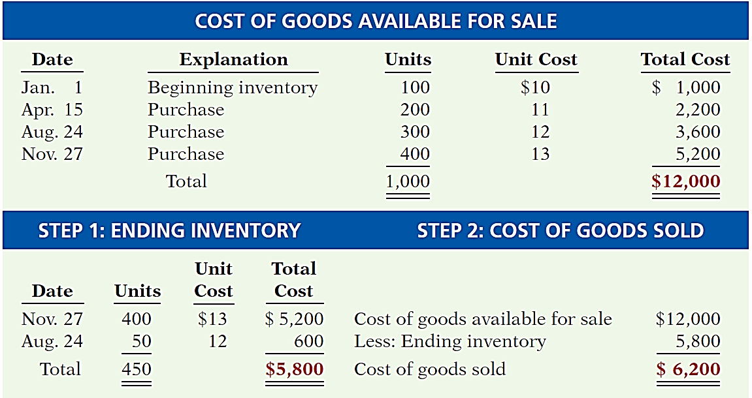
FIRST-IN, FIRST-OUT (FIFO)
550 units sold and 450 units in ending inventory

Slide 9
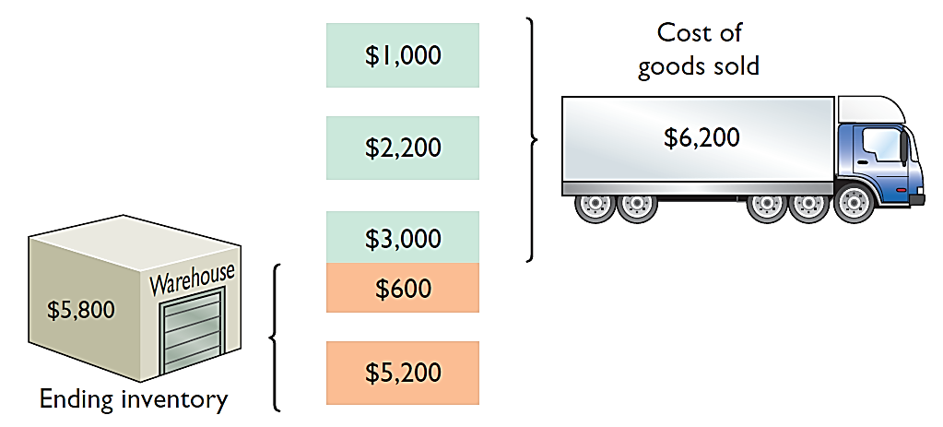
FIRST-IN, FIRST-OUT (FIFO)

Slide 10
Cost Flow Assumptions
LAST-IN, FIRST-OUT (LIFO)
  Costs of the latest goods purchased are the first to be recognized in determining cost of goods sold.
  Seldom coincides with actual physical flow of merchandise.
  Exceptions include goods stored in piles, such as coal or hay.

Slide 11
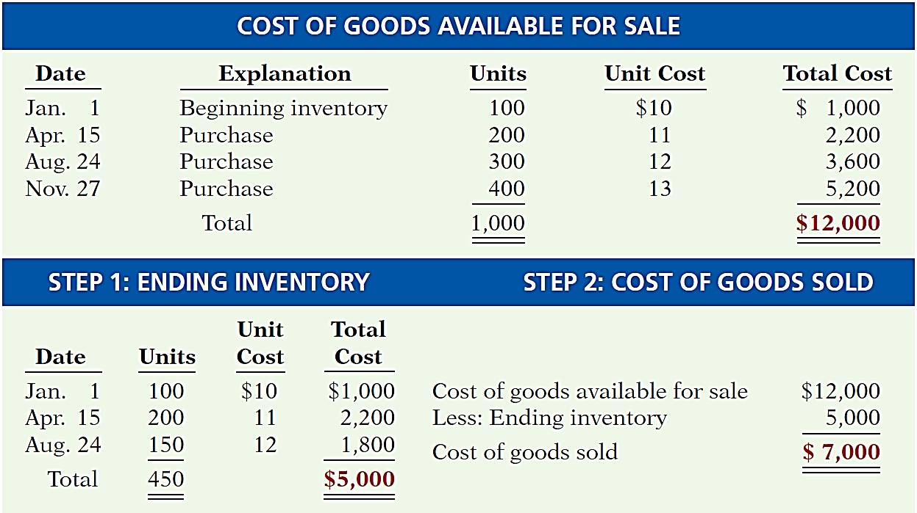
LAST-IN, FIRST-OUT (LIFO)
550 units sold and 450 units in ending inventory

Slide 12
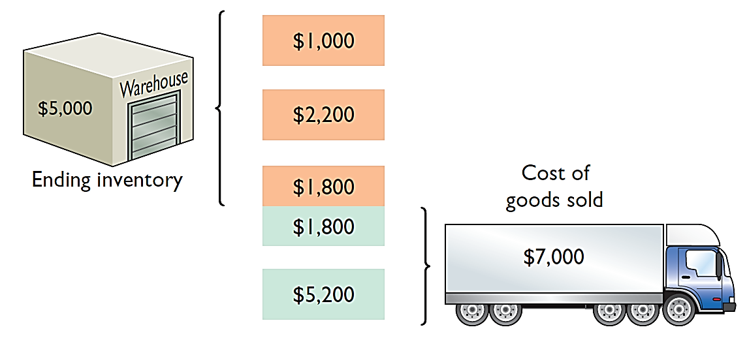
LAST-IN, FIRST-OUT (LIFO)

Slide 13
Cost Flow Assumptions
AVERAGE-COST
  Allocates cost of goods available for sale on the basis of weighted-average unit cost incurred.
  Applies weighted-average unit cost to the units on hand to determine cost of the ending inventory.

Slide 14
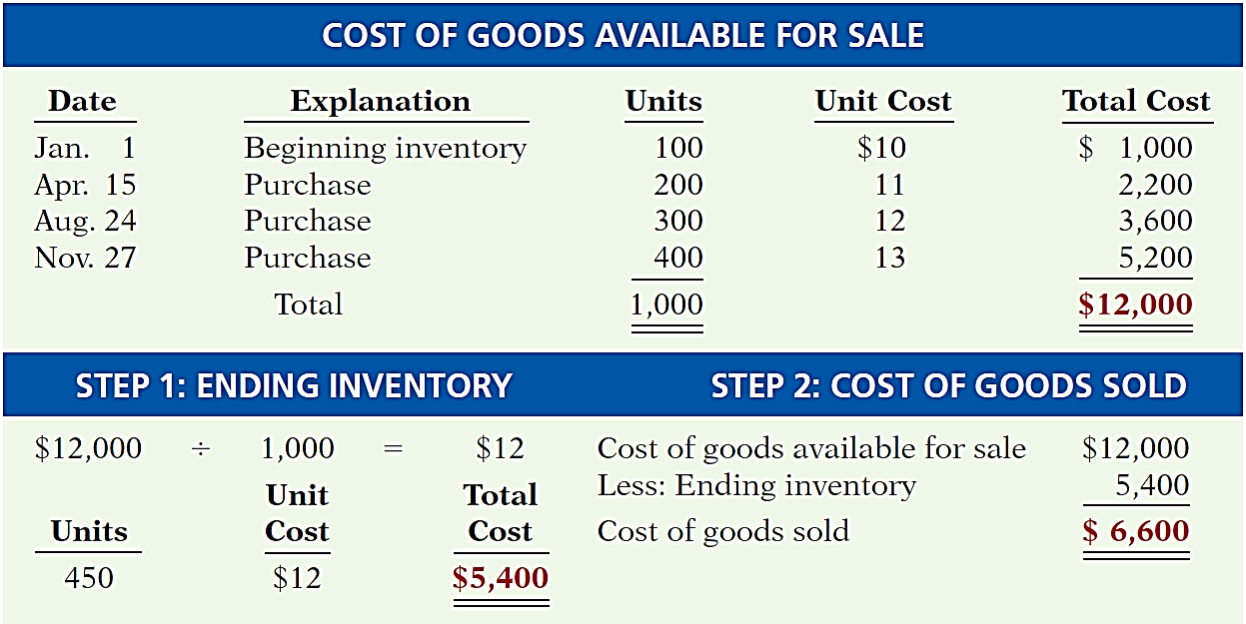
AVERAGE-COST
550 units sold and 450 units in ending inventory

Slide 15
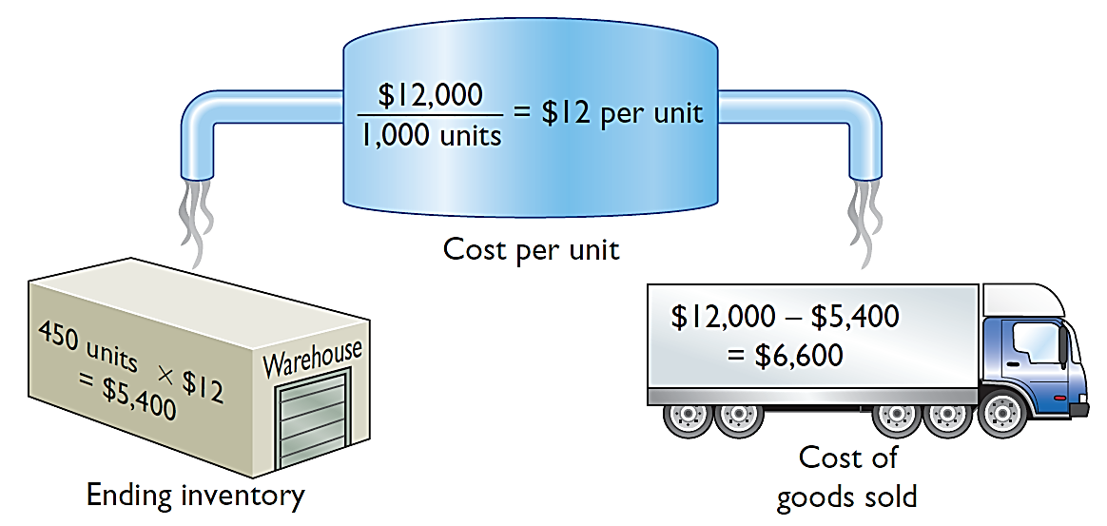
AVERAGE-COST

Slide 16
Financial Statement and Tax Effects
  Each of the three cost flow methods is acceptable for use. There are three main reasons why companies may adopt different inventory cost flow methods:
  Income statement effects
  Balance sheet effects
  Tax effects

Slide 17
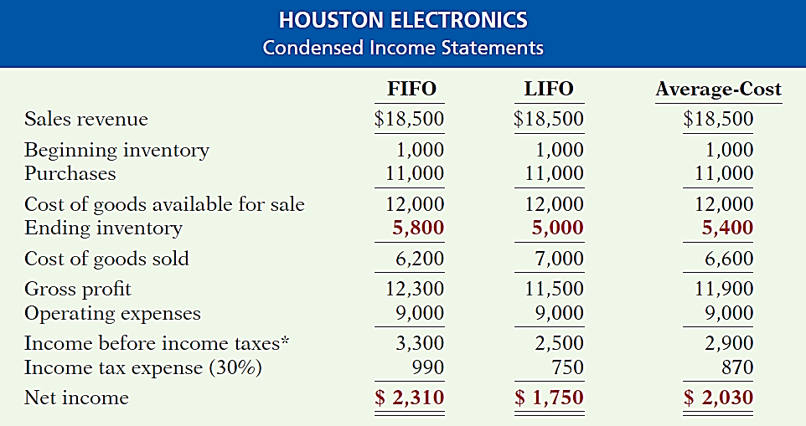

Financial Statement and Tax Effects
INCOME STATEMENT EFFECTS
Rising prices!!!
Highest
Lowest

Slide 18
Financial Statement and Tax Effects
BALANCE SHEET EFFECTS
  A major advantage of the FIFO method is that in a period of inflation, the costs allocated to ending inventory will approximate their current cost.
  A major shortcoming of the LIFO method is that in a period of inflation, the costs allocated to ending inventory may be significantly understated in terms of current cost.

Slide 19
Financial Statement and Tax Effects
TAX EFFECTS
  Both inventory and net income are higher when companies use FIFO in a period of inflation.
  LIFO results in the lowest income taxes (because of lower net income) during times of rising prices.
Helpful Hint
A tax rule, often referred to as the LIFO conformity rule, requires that if companies use LIFO for tax
purposes they must also use
it for financial reporting purposes.

